Slide 1

Power BI - I
Course 3 (Week 3)
Lecture 2:
Power BI Basics: Interface, importing data, creating visualizations.

Slide 2
What’s a personal goal you’re currently working toward?
Notes:
(except regular studies)

Slide 3
Skills Covered
Navigating the Power BI interface and its essential features.
Importing datasets into Power BI for analysis.
Creating basic visualizations using Power BI (bar charts, line charts, pie charts, etc.).
Applying filters and slicers to enhance interactivity.
Notes:
Designing Interactive Dashboards
Introduction to DAX (Data Analysis Expressions)
Data Modeling in Power BI

Slide 4
Learning Outcomes
By the end of this session, students will be able to:
Understand and navigate the Power BI interface effectively.
Import datasets from Excel or other sources into Power BI for data analysis.
Create and customize basic visualizations (bar charts, pie charts, line charts).
Use filters and slicers to add interactivity to their reports and visualizations.

Slide 5
Objectives for today
Power BI Interface
Data Import in Power BI
Creating Visualizations Using Power BI
Short project: Build a report using the imported dataset and multiple visualizations.

Slide 6
Introduction to Power BI
Section 1
Section 2
Section 3
Section 4
Section 5

Slide 7
History of Power BI
Launched by Microsoft in 2013 as a self-service BI tool.
Evolved from Excel add-ins like Power Pivot and Power Query.
Now a full-fledged suite of business intelligence tools with frequent updates.

Slide 8
Purpose
To provide users with tools to transform raw data into meaningful insights through visualizations.
Aimed at business users and analysts for creating reports, dashboards, and data models without needing a deep technical background.

Slide 9
Current Uses
Widely used across industries for decision-making based on real-time data.
Commonly used for creating interactive dashboards, reports, and sharing insights across organizations.
Integration with Microsoft tools like Excel, Azure, and Teams enhances its adoption.
Popular in sales, marketing, finance, healthcare, and operations for tracking KPIs, analyzing trends, and making data-driven decisions.

Slide 10


Power BI Desktop
Power BI Service
A free Windows application used primarily for data modeling, data import, and report creation.
A cloud-based platform that allows users to view, share, and collaborate on reports and dashboards created in Power BI Desktop.

Slide 11
Business Intelligence
BI refers to the technologies, strategies, and practices used by organizations to analyze business data and make informed decisions.
Tools like Power BI help businesses gather data from multiple sources, analyze it, and convert it into actionable insights.
The main goal of BI is to enable better decision-making by providing a comprehensive view of business data.

Slide 12
Why are Visualizations important?
Clarity: Visual representations of data (charts, graphs) make complex data easy to understand at a glance.
Efficiency: Visual data allows quicker analysis and interpretation, enabling faster decision-making.
Insight Discovery: Patterns, trends, and correlations in data become more apparent through visualization.
Communication: Data visualization facilitates effective communication of insights to stakeholders who may not have a technical background.
Interactivity: Modern BI tools, like Power BI, provide interactive dashboards that allow users to explore data dynamically and gain deeper insights.

Slide 13
What we will cover in demo
Setup
Interface
Power Query Editor
Views, Filters, Visualizations

Slide 14
Hands-on activity over a dataset
Importing Data
Data Transformation
Creating Visualizations
Exporting Reports

Slide 15
Next up:
BI Reporting
Interactive Dashboarding
Advanced Power BI
DAX for Data Analysis
Hands-on Project

Slide 16
Report vs Dashboard

Slide 17
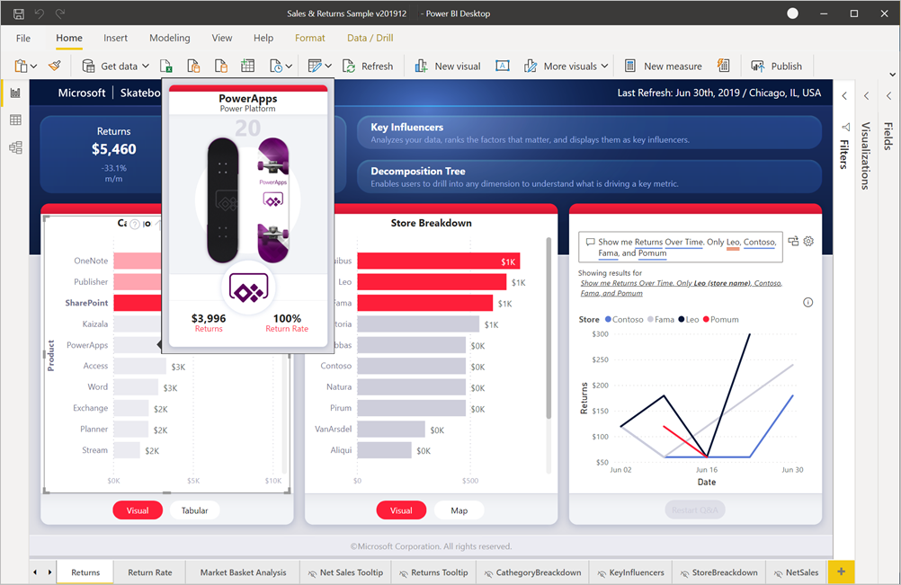
A report is a detailed, multi-page document that presents data in various visual formats like tables, charts, and graphs.
Users can drill down into individual visualizations, filter data, and interact with various elements within the report.
Report

Slide 18
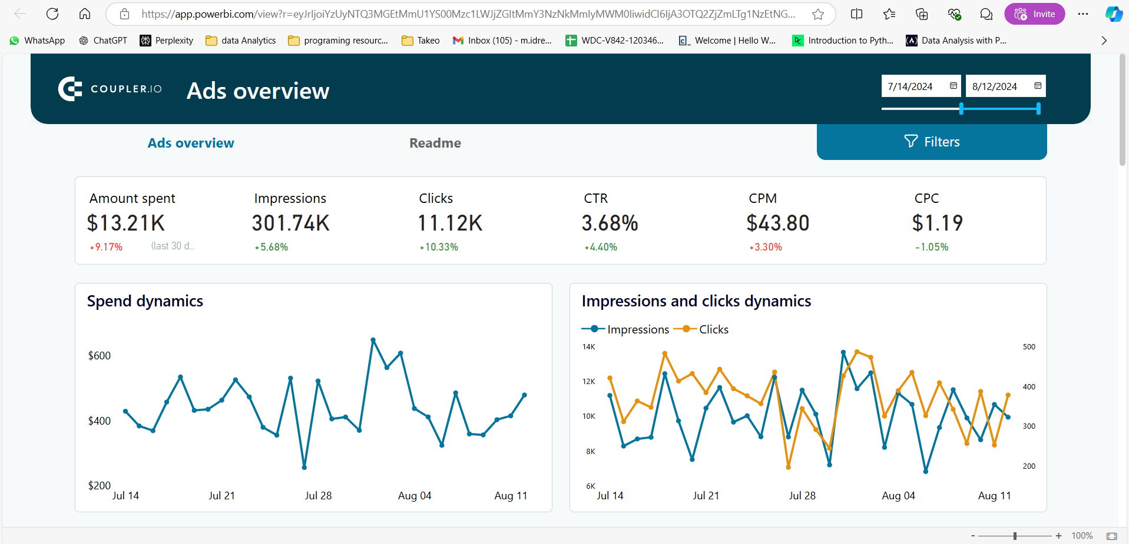
A dashboard is a single-page, real-time snapshot of key metrics or KPIs that presents data visually.
Dashboards are more static compared to reports. Users can click on tiles to view the underlying report but can’t interact with visuals in as much depth.
Dashboard

Slide 19
File formats
.pbix: Power BI Desktop file. standard file format used to save Power BI reports and data models. Can only be opened and modified in Power BI Desktop. The file can include data from multiple sources, visualizations
.pbit: Power BI Template file. to save templates that can be reused for multiple reports. When a .pbit file is opened, it prompts the user to provide the data source, as the actual data is not stored in the file.

Slide 20
File formats
.pbix (in Power BI Service): The same Power BI Desktop file, but used in Power BI Service .pbix file from Power BI Desktop to Power BI Service, it allows sharing and collaboration in the cloud. file remains in .pbix format but is hosted and managed online.
.pnib: Power BI Project File (Preview). used for more complex development work with Power BI, especially when creating solutions that involve multiple .pbix files. organizes multiple .pbix files and related resources, but is not yet as widely adopted

Slide 21
File Format | Description | Use | Implication
.pbix | Power BI Desktop file | Standard report and data model | Can be opened and edited in Power BI Desktop
.pbit | Power BI Template file | Reusable templates without data | Prompts user for data source when opened
.pbix (Service) | Published Power BI report | Share and collaborate online | Same as .pbix, but hosted in Power BI Service
.csv | Comma-Separated Values | Simple data file | Only stores data, no metadata or visuals
.xlsx | Excel Spreadsheet | Import data from Excel | Can include data tables, ranges, and Power Query
.xml | XML file | Import structured data from XML | Useful for structured data like feeds
.json | JSON file | Import hierarchical data | Ideal for nested data structures
.xmla | XML for Analysis | Used with SSAS multidimensional models | For querying OLAP models in Power BI
.rdl | Report Definition Language | Used with SSRS for paginated reports | Static reports typically for printing
.pbip | Power BI Project File (Preview) | Organize complex Power BI solutions | Manage multiple .pbix files and resources

Slide 22
Let’s move to interface now!

Slide 23
Hands-on Activity
Activity: Visualize Your Favorite Movies

Slide 24
Objectives
Learn Power BI basics by creating a movie dashboard
Use IMDb movie dataset to explore movie trends, genres, and ratings
Build an interactive dashboard to visualize key insights

Slide 25
Step 1 - Importing Data
Download the IMDb movie dataset IMDB 5000 Movie Dataset (kaggle.com)
Open Power BI and import the dataset into the platform
Explore columns like movie title, genre, release year, ratings

Slide 26
Step 2 - Data Cleaning
Use Power Query Editor to:
Remove duplicates or irrelevant columns
Convert data types (numeric values for ratings, box office)
Handle missing data (remove, replace, etc.)

Slide 27
Step 3 - Creating Visuals
Create a Bar Chart for top 10 highest-grossing movies
Use a Pie Chart for genre distribution
Make a Line Graph to show trends in movie production or ratings over time

Slide 28
Step 4 - Building the Dashboard
Combine all visuals into one dashboard
Add a title: "Explore Your Favorite Movies!"
Label visuals and arrange them neatly

Slide 29
Step 5 - Explore and Share
Discover insights about genres, ratings, and top movies
Share your findings with the class

Slide 30
Resources
Microsoft Documentation - Tutorial: Get started creating in the Power BI service - Power BI | Microsoft Learn
Learn PowerBI Dashboarding: Create dashboards in Power BI - Training | Microsoft Learn
Power BI Tutorial for Beginners | DataCamp
Power BI Tutorial | Learn Power BI – GeeksforGeeks
Power BI Tutorial for Beginners – YouTube

Slide 31
Any Questions?
That’s a wrap

